Slide 1
Intro to Machine Learning
Notes:
What is exactly is Machine Learning?
Basic definition:
The field of study that gives computers the ability to learn without being explicitly programmed.
Technical definition:
The creation and evaluation of algorithms that facilitate pattern recognition, classification, and prediction, based on models derived from existing data. Or more formally: program P is said to learn from experience E with respect to some task T and some performance P, if it’s performance on T, as measured by P improves with experience E.

Slide 2
Types of learning
Machine Learning is divided into several subfields, based on:
Learning: supervised, unsupervised or something in between – reinforcement or semi-supervised
Learner: actively asking for examples or passively getting them
Teacher: random or adversarial
Processing: online or offline/batch
Notes:
What is behind Machine Learning?
The two main paradigms in machine learning are supervised and unsupervised learning.
Supervised Learning:
Objects in a given collection are classified using a set of attributes, or features. The result of the classification process is a set of rules that prescribe assignments of objects to classes based solely on values of features.
Unsupervised learning:
Objects are not assigned class labels. The goal is to explore the data and discover similarities between objects. Similarities are used to define groups of objects, referred to as clusters.

Slide 3
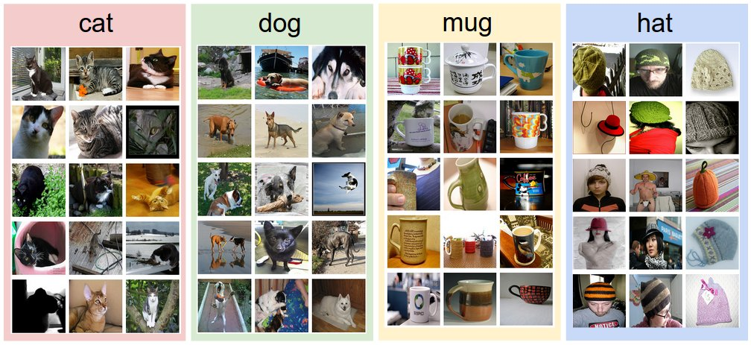
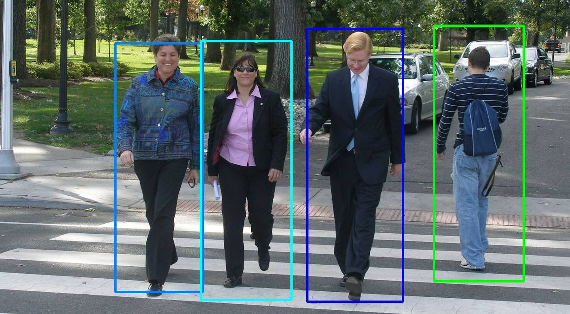
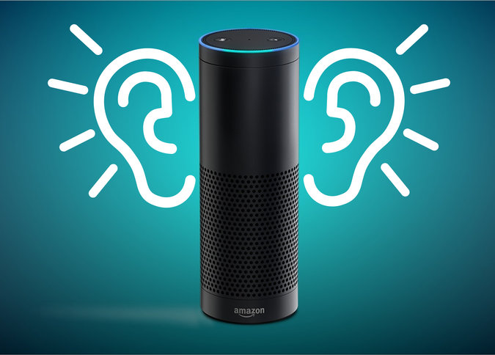
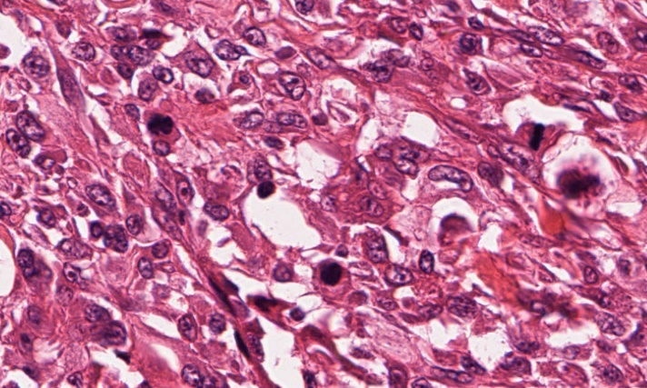

Supervised Learning

Slide 4
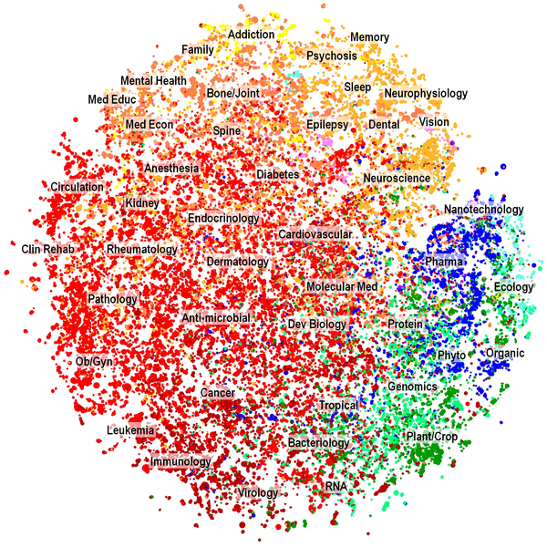
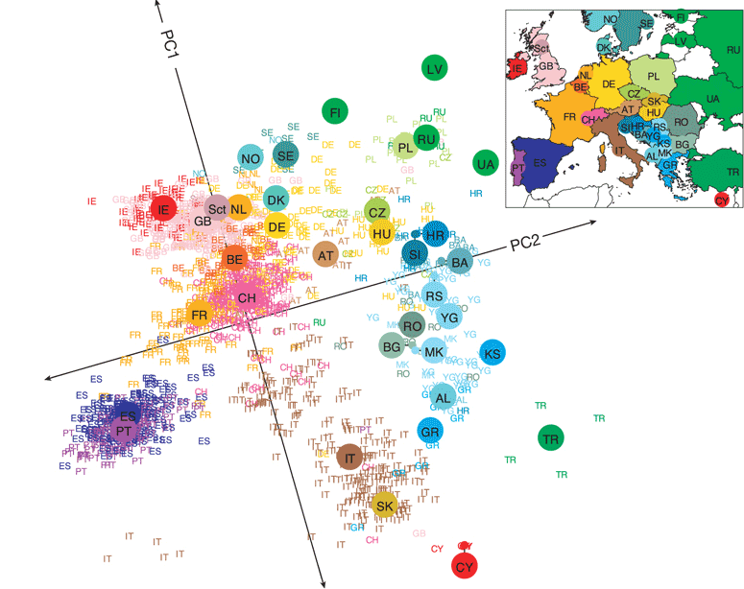
Unsupervised Learning

Slide 5
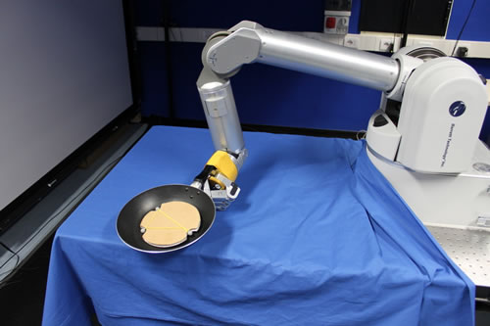
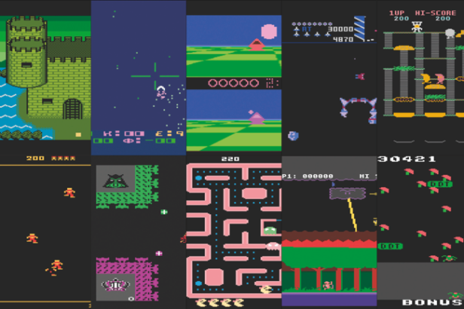
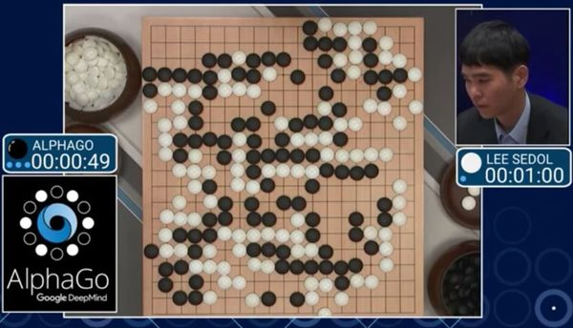


Reinforcement Learning
OpenAI: Universe

Slide 6
Introduction to Machine Learning
Classification – Predict answers to Yes/No questions
Regression – Predict real values
Clustering – Find patterns of similar objects
How to Evaluate Machine Learning Models

Slide 7
Classification
Notes:
A classification algorithm takes as input some examples and their values (labels), and, using these examples, is able to predict the values of new data.
Email: Spam / Not Spam?
Online transactions: Fraudulent (Yes/No)?
Tumor: Malignant/Benign?

Slide 8
Machine Learning
Grew out of artificial intelligence within computer science. Teaches computers by example.
ML is arguably part of statistics.
Is this a chair?
Notes:
Machine learning as a field, *read*
If we want to teach the computer to recognize images of chairs, then we give the computer a whole bunch of images, and tell it which ones are chairs and which are now, and then it’s supposed to learn to recognize chairs, even ones it hasn’t seen before. It’s not like we tell the computer how to recognize a chair, we don’t tell it “a chair has 4 legs and a back and a flat surface to sit on and so on”, we just give it a lot of examples.
Machine learning has close ties to statistics, in fact it’s hard to say what’s different about predictive statistics and machine learning, and these fields are very closely linked right now.

Slide 9

Classification
We have a training set of observations (e.g., labeled images) and a test set that we use only for evaluation.
Training set
Test set
(not a chair)
(chair)
(not a chair)
(chair)
(not a chair)
(not a chair)
(not a chair)
(not a chair)
Notes:
The problem I just told you about is a classification problem where we are trying to identify chairs. The way we set the problem up is that we have a *read*
We use the training set to learn a model of what a chair is. The test set are images that are not in the training set, and we want to be able to make predictions on those, as to whether or not each image is a chair.
It could be that some the labels on the training set are noisy. That could happen. In fact one if these labels is noisy *point*. That’s ok, because as long as their isn’t too much noise, we should still be able to learn a model for a chair. It just won’t be able to classify perfectly, and that happens. Some prediction problems are harder than others, but that’s ok, we just do the best we can from the training data. And in terms of the size of the training data, the more the merrier. We want as much data as we can to train these models.

Slide 10


Classification
Each observation is represented by a set of numbers (features).
Each pixel gets rgb values like [1.0,0.9,0.8]
Image becomes:
[1.0,0.9,0.8,0.1,0.5,…]
(Label is -1, it’s not a chair)
Notes:
How do we represent an image of a chair, or a flower, or whatever, in the training set? I just zoomed in on a piece of this image over here, and you can see that the pixels in the image. We can represent each pixel according to its rgb values (red green blue), so we get three numbers representing each image. So you can represent the whole image as a collection of rgb values. So the image becomes this very large vector of numbers. And in general, when doing machine learning, we need to represent each observation in the training and test sets as a vector of numbers. The label is also represented by a number. Here the number is -1 because the image is not a chair. The chairs would all get label +1.

Slide 11
Classification
Each observation is represented by a set of numbers (features).
Manhole is represented as: [ 5 3 120 12 1 0 ….. ]
Inspected?
Vented cover?
Number of events last year
Number of electrical cables
Number of serious events last year
Number of pre-1930 electrical cables
Notes:
Here’s another example. This is a problem that comes from NYC’s power company, where they wanted to predict which manholes were going to have a fire. So we would represent each manhole as a vector, and here are the components in the vector. The first component might be *read*.
In general, the first step is to figure out how to represent your data as a vector. You can make the vector very large, you can include lots of factors if you like, that’s fine. Computationally things are easier if you use fewer features, but then you risk leaving out information. So there’s a tradeoff right there that you will have to worry about, and we’ll talk more about that later. But in any case, you can’t do ML if you don’t have your data represented this way, so that’s the first step. *pause*
You’d think that manholes with more cables, more recent serious events, etc. would be more prone to explosions and fires in the future. But what combination of them would give you the best predictor? How do you combine them together? You could add them all up but that might not be the best thing. You could give them all weights and add them up, but how do you know the weights? That’s what ML does for you. It tells you what combinations to use to get the best predictors.

Slide 12
Classification
Each observation is represented by a set of numbers (features).
Manhole is represented as: [ 5 3 120 12 1 0 ….. ]
Inspected?
Vented cover?
Number of events last year
Number of electrical cables
Number of serious events last year
Number of pre-1930 electrical cables
Training feature data is from 2014 and before
(Label is 1, it exploded in 2013)
Notes:
For the manhole problem, we want to use the data from the past to predict the future. So, for instance, the feature data might be from 2014 and before.

Slide 13
Classification
Each observation is represented by a set of numbers (features).
Manhole is represented as: [ 5 3 120 12 1 0 ….. ]
Inspected?
Vented cover?
Number of events last year
Number of electrical cables
Number of serious events last year
Number of pre-1930 electrical cables
Training feature data is from 2014 and before
Label is 1 if it had an event in 2015
Notes:
*read* so that’s our training set.

Slide 14
Classification
Each observation is represented by a set of numbers (features).
Manhole is represented as: [ 5 3 120 12 1 0 ….. ]
Inspected?
Vented cover?
Number of events last year
Number of electrical cables
Number of serious events last year
Number of pre-1930 electrical cables
Testing feature data is from 2015 and before
Predict what happen in 2016
Notes:
*Read* we predict the labels for 2016.

Slide 15
Classification
Each observation is represented by a set of numbers (features).
Manhole is represented as: [ 5 3 120 12 1 0 ….. ] -1
[ 0 0 89 5 1 1 ….. ] 1
[ 1 0 20 0 0 1 ….. ] -1
: :
Features, called X
Labels, called Y
(Predictors, Covariates, Explanatory Variables, Independent Variables)
Notes:
Just to be formal about it, *Read*
The features are also called *read* so you can choose whatever terminology you like.

Slide 16
Classification
Formally, given training set (x_{i,}y_{i}) for i=1…n, we want to create a classification model f that can predict label y for a new x.
Notes:
Even more formally, we are given a training set of feature label pairs xi yi, and there are n of them, and

Slide 17
Classification
Formally, given training set (x_{i,}y_{i}) for i=1…n, we want to create a classification model f that can predict label y for a new x.
Manhole is represented as: [ 1925 15]
Year oldest cable installed
Number of events last year
Notes:
Let’s take a simple version of the manhole example where we have only two features, *Read*. So each observation can be represented as a point on a 2d graph, which means I can plot the whole dataset.

Slide 18
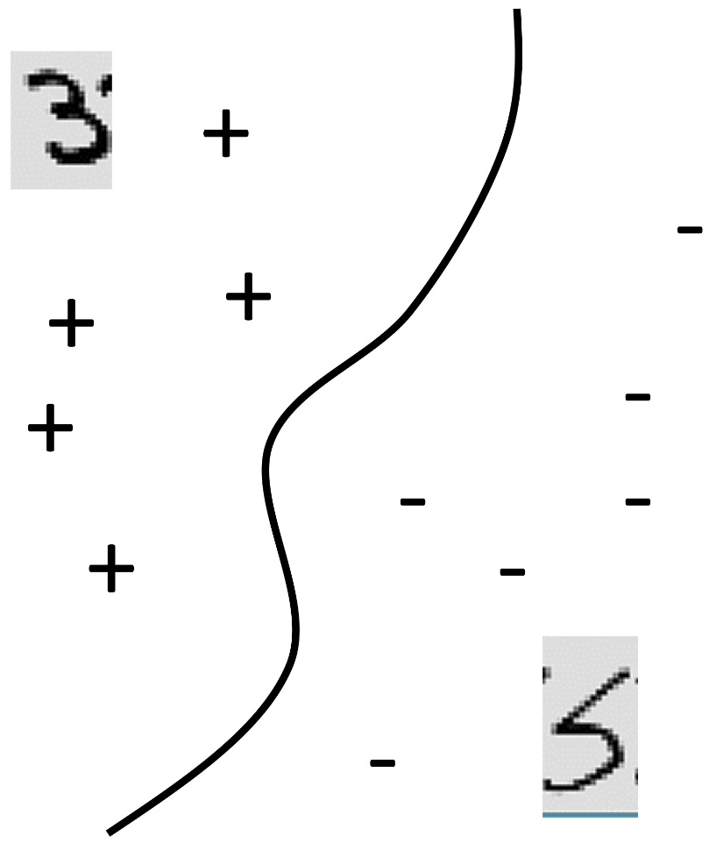
Classification
Formally, given training set (x_{i,}y_{i}) for i=1…n, we want to create a classification model f that can predict label y for a new x.
20
Manhole is represented as: [ 1925 15]
Events Last Year
Year oldest cable installed
Number of events last year
0
1925
Oldest cable
2015

Slide 19
Classification
Formally, given training set (x_{i,}y_{i}) for i=1…n, we want to create a classification model f that can predict label y for a new x.
20
f(x)>0
f(x)=0
f(x)<0
Manhole is represented as: [ 1925 15]
Events Last Year
Year oldest cable installed
Number of events last year
0
1925
Oldest cable
2015

Slide 20
Classification
Formally, given training set (x_{i,}y_{i}) for i=1…n, we want to create a classification model f that can predict label y for a new x.
20
f(x)>0
f(x)=0
f(x)<0
f(x) = function(Events Last Year, Oldest Cable)
Events Last Year
0
1925
Oldest cable
2015

Slide 21
Classification
Formally, given training set (x_{i,}y_{i}) for i=1…n, we want to create a classification model f that can predict label y for a new x.

Slide 22
Classification
Formally, given training set (x_{i,}y_{i}) for i=1…n, we want to create a classification model f that can predict label y for a new x.
The machine learning algorithm will create the function f.
The predicted value of y for a new x is sign(f(x)).
Notes:
. It might be very complicated, but the way to use is is not complicated:

Slide 23
Classification
Yes/No questions – binary classification
automatic handwriting recognition, speech recognition, biometrics, document classification, spam detection, predicting credit default risk, detecting credit card fraud, predicting customer churn, predicting medical outcomes (strokes, side effects, etc.)
Notes:
You can do a lot if you can answer yes/no questions. For instance, think about handwriting recognition. For each letter on a page, we’re going to evaluate whether it’s a letter A, yes or no. Your spam detector in your computer has machine learning in it – each email that comes in has to be evaluated as to whether or not it is spam. Credit defaults – whether or not you get a loan depends on whether the bank predicts that you’re going to default on that loan or not, yes or no. In my lab, we do a lot of work on predicting medical outcomes. We want to know whether something will happen to a patient within a particular period of time.

Slide 24
Classification
Common algorithms:
Logistic Regression (with L1 or L2 regularization)
Decision Trees / Classification Trees / CART / C4.5 / C5.0
AdaBoost (Boosted Decision Trees)
Support Vector Machines
Random Forests
Neural Networks
You never need to program these.
Notes:
Most likely, unless you’re interested in developing your own algorithms, you will never need to program these yourself, they are already programmed in by someone else. If you’re just going to be a consumer of these, you can use the code that’s already written for them. All of these are covered in the intro to ML course. But in order to use them effectively, you have to know what they are doing. Otherwise you could run into issues. But if you can figure out how to use these, you have an extremely powerful tool on your hands.

Slide 25
Regression
Notes:
regression

Slide 26
Regression
For predicting real-valued outcomes:
How many customers will arrive at our website next week?
How many tv’s will we sell next year?
Can we predict someone’s income from their click through information?
Notes:
Supervised regression = regression

Slide 27
Regression
Each observation is represented by a set of numbers.
Income
A person is represented as: [ 5 3 120 12 1 0 ….. ] 84
[ 0 0 89 5 1 1 ….. ] 32
[ 1 0 20 0 0 1 ….. ] -10
: :
Features, called X
Labels, called Y

Slide 28
Regression
Each observation is represented by a set of numbers.
Income
A person is represented as: [ 5 ] 84
[ 0 ] 32
[ 1 ] -10
:
Single feature, called X
Labels, called Y

Slide 29
Regression
Formally, given training set (x_{i,}y_{i}) for i=1…n, we want to create a regression model f that can predict label y for a new x.
1,000K
f(x) = function(Number of Businessweek clicks)
f(x)
Income
0
2000
0
Number of Businessweek clicks

Slide 30
Regression
Formally, given training set (x_{i,}y_{i}) for i=1…n, we want to create a regression model f that can predict label y for a new x.
1,000K
f(x) = function(Number of Businessweek clicks)
f(x)
Income
(Overfitting?)
0
2000
0
Number of Businessweek clicks

Slide 31
Regression
Formally, given training set (x_{i,}y_{i}) for i=1…n, we want to create a regression model f that can predict label y for a new x.
1,000K
f(x) = function(Number of Businessweek clicks)
= 5K*Number of Businessweek clicks + 100K
f(x)
Income
(Underfitting?)
0
2000
0
Number of Businessweek clicks

Slide 32
Regression
Formally, given training set (x_{i,}y_{i}) for i=1…n, we want to create a regression model f that can predict label y for a new x.
1,000K
f(x) = function(Number of Businessweek clicks)
f(x)
Income
(Just right?)
We’ll talk more about this later
0
2000
0
Number of Businessweek clicks

Slide 33
Regression
Formally, given training set (x_{i,}y_{i}) for i=1…n, we want to create a regression model f that can predict label y for a new x.
Estimated income:
f(x) = function(Number of visits to upscale furniture websites, Number of Businessweek clicks, Number of distinct people emailed per day, Number of purchases of over 5K within the last month, Number of visits to airlines, etc.)
For instance,
f(x) = 3*Number of visits to upscale furniture websites
+10*Number of Businessweek clicks
+100*Number of distinct people emailed per day
+2*Number of purchases of over 5K within the last month
+10*Number of visits to airlines
But f(x) could be much more complicated
Notes:
Could include number… times number of ..., Or if could have a complicated function like log or square root in it.

Slide 34
Regression Applications
Predict monetary amounts
Predict consumption or demand for products/energy

Slide 35
Supervised Learning
“Supervised” means that the training data has ground truth labels to learn from. Classification and Regression are supervised learning problems.
(Supervised) classification often has +1 or -1 labels.
(Supervised) regression has numerical labels.
Supervised learning algorithms are much easier to evaluate than unsupervised ones.
Notes:
There are lots of other supervised problems.

Slide 36



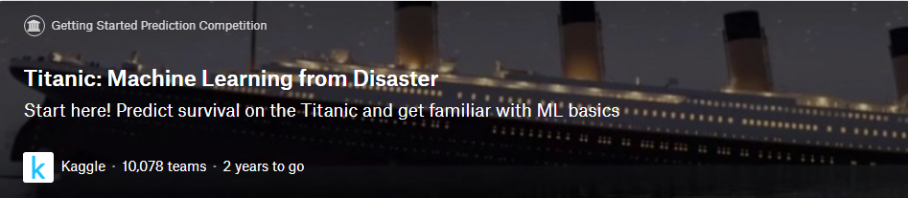
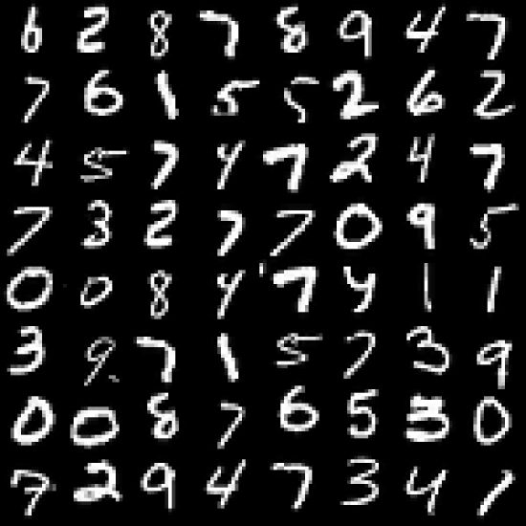

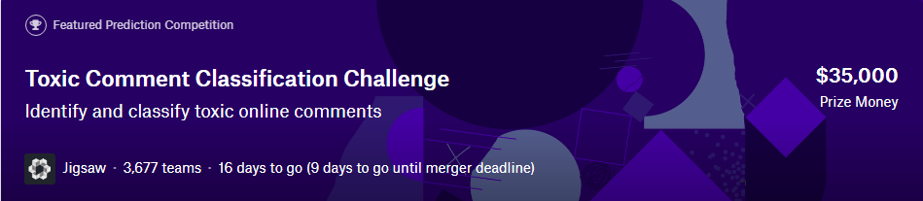
How do I start?
Digit Recognizer
Learn machine learning fundamentals with the famous MNIST data
Kaggle 1,827 teams 2 years to go
Notes:
Kaggle is a platform for predictive modelling and analytics competitions in which statisticians and data miners compete to produce the best models for predicting and describing the datasets uploaded by companies and users. This crowdsourcing approach relies on the fact that there are countless strategies that can be applied to any predictive modelling task and it is impossible to know beforehand which technique or analyst will be most effective.
How Kaggle competitions work
The competition host prepares the data and a description of the problem. Kaggle offers a consulting service which can help the host to do this, as well as frame the competition, anonymize the data, and integrate the winning model into their operations.
Participants experiment with different techniques and compete against each other to produce the best models. Work is shared publicly through Kaggle Scripts to achieve a better benchmark and to inspire new ideas. Submissions are made through Scripts or through private manual upload. For most competitions, submissions are scored immediately (based on their predictive accuracy relative to a hidden solution file) and summarized on a live leaderboard.
After the deadline passes, the competition host pays the prize money in exchange for "a worldwide, perpetual, irrevocable and royalty free license [...] to use the winning Entry", i.e. the algorithm, software and related intellectual property developed, which is "non-exclusive unless otherwise specified".^{[4]} For recruiting competitions, the competition host will screen participants based on their place on the leaderboard, final score, and submitted Scripts if applicable. They will reach out to competitors who look like strong candidates for their open roles to arrange interviews.

Slide 37
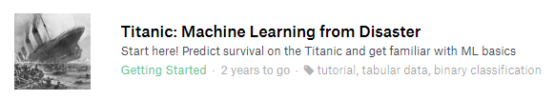
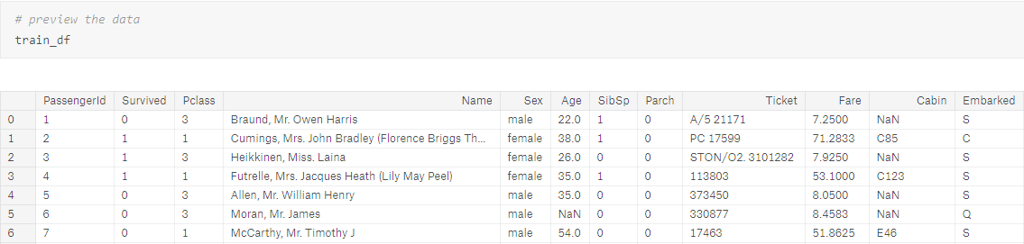
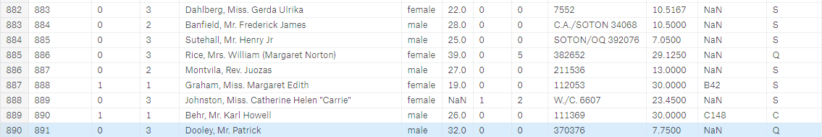
The sinking of the RMS Titanic is one of the most infamous shipwrecks in history. On April 15, 1912, during her maiden voyage, the Titanic sank after colliding with an iceberg, killing 1502 out of 2224 passengers and crew.
Notes:
Titanic: Machine Learning from Disaster
Start here! Predict survival on the Titanic and get familiar with ML basics
Start here if...
You're new to data science and machine learning, or looking for a simple intro to the Kaggle prediction competitions.
Competition Description
One of the reasons that the shipwreck led to such loss of life was that there were not enough lifeboats for the passengers and crew. Although there was some element of luck involved in surviving the sinking, some groups of people were more likely to survive than others, such as women, children, and the upper-class.
In this challenge, we ask you to complete the analysis of what sorts of people were likely to survive. In particular, we ask you to apply the tools of machine learning to predict which passengers survived the tragedy.

Slide 38
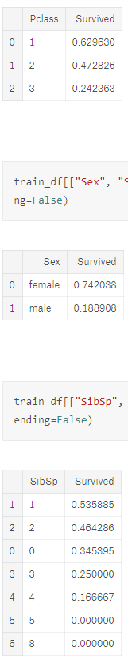
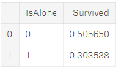
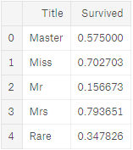
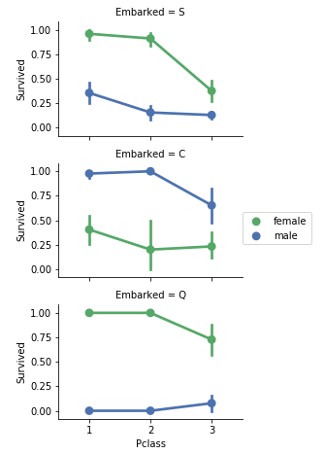
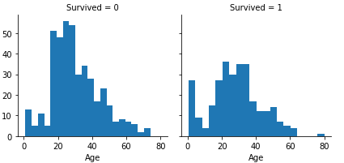
Notes:
Goal
It is your job to predict if a passenger survived the sinking of the Titanic or not. For each PassengerId in the test set, you must predict a 0 or 1 value for the Survived variable.
Metric
Your score is the percentage of passengers you correctly predict. This is known simply as "accuracy”.
Which features are categorical?
These values classify the samples into sets of similar samples. Within categorical features are the values nominal, ordinal, ratio, or interval based? Among other things this helps us select the appropriate plots for visualization.
Categorical: Survived, Sex, and Embarked. Ordinal: Pclass.
Which features are numerical?
Which features are numerical? These values change from sample to sample. Within numerical features are the values discrete, continuous, or timeseries based? Among other things this helps us select the appropriate plots for visualization.
Continous: Age, Fare. Discrete: SibSp, Parch.

Slide 39
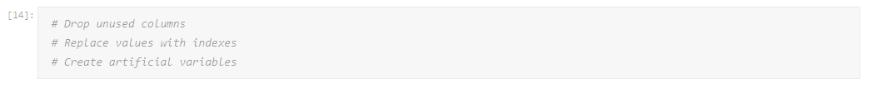
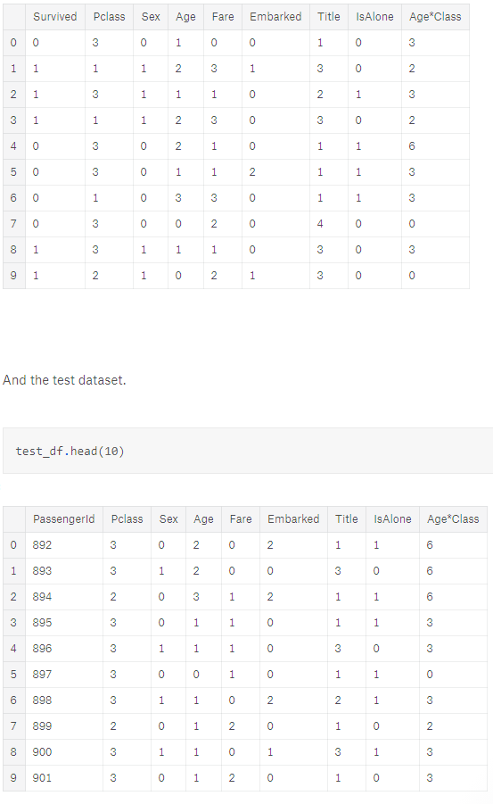
Notes:
Workflow goals
The data science solutions workflow solves for seven major goals.
Classifying. We may want to classify or categorize our samples. We may also want to understand the implications or correlation of different classes with our solution goal.
Correlating. One can approach the problem based on available features within the training dataset. Which features within the dataset contribute significantly to our solution goal? Statistically speaking is there a correlation among a feature and solution goal? As the feature values change does the solution state change as well, and visa-versa? This can be tested both for numerical and categorical features in the given dataset. We may also want to determine correlation among features other than survival for subsequent goals and workflow stages. Correlating certain features may help in creating, completing, or correcting features.
Converting. For modeling stage, one needs to prepare the data. Depending on the choice of model algorithm one may require all features to be converted to numerical equivalent values. So for instance converting text categorical values to numeric values.
Completing. Data preparation may also require us to estimate any missing values within a feature. Model algorithms may work best when there are no missing values.
Correcting. We may also analyze the given training dataset for errors or possibly innacurate values within features and try to corrent these values or exclude the samples containing the errors. One way to do this is to detect any outliers among our samples or features. We may also completely discard a feature if it is not contribting to the analysis or may significantly skew the results.
Creating. Can we create new features based on an existing feature or a set of features, such that the new feature follows the correlation, conversion, completeness goals.
Charting. How to select the right visualization plots and charts depending on nature of the data and the solution goals.

Slide 40
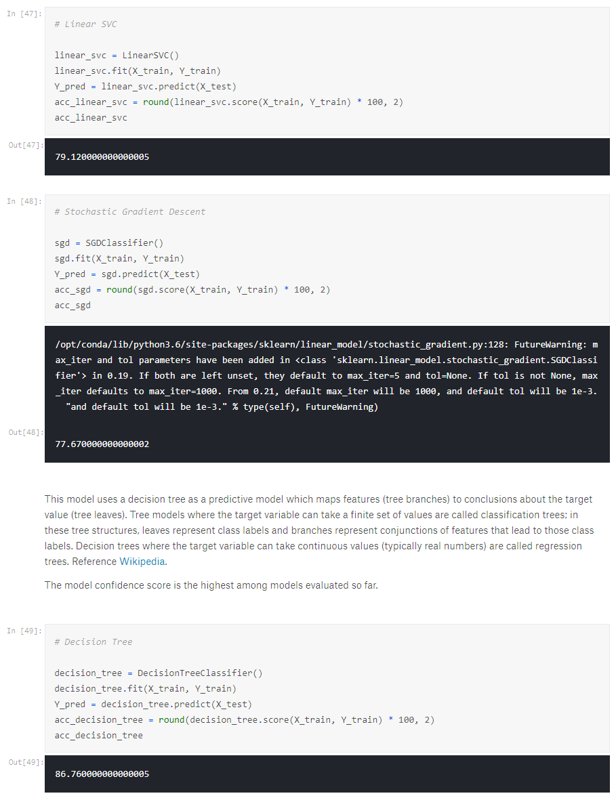
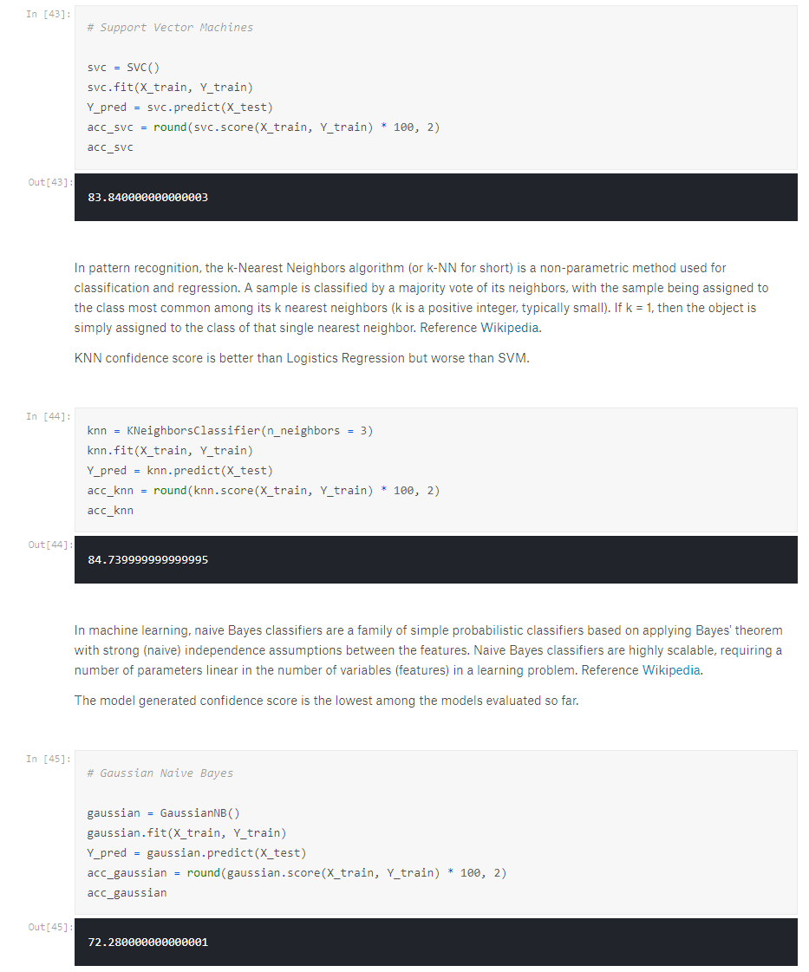
Notes:
This model uses a decision tree as a predictive model which maps features (tree branches) to conclusions about the target value (tree leaves). Tree models where the target variable can take a finite set of values are called classification trees; in these tree structures, leaves represent class labels and branches represent conjunctions of features that lead to those class labels. Decision trees where the target variable can take continuous values (typically real numbers) are called regression trees.

